Slide 1
Employee Data Analysis using Excel
STUDENT NAME: HINDHUJA P.R
REGISTER NO:122202157
DEPARTMENT: B.COM (CS)
COLLEGE; ANNA ADARSH COLLEGE FOR WOMEN

Slide 2
PROJECT TITLE
Employee Performance Analysis using Excel

Slide 3


AGENDA
Problem Statement
Project Overview
End Users
Our Solution and Proposition
Dataset Description
Modelling Approach
Results and Discussion
Conclusion
3/21/2024 Annual Review

Slide 4

PROBLEM STATEMENT
Employee data analysis can present various challenges and issues that organizations need to address.
Here's an overview of common problems encountered in employee data analysis:
Data Quality Issues
Privacy and Compliance
Bias in Analysis
Integration and Accessibility

Slide 5

PROJECT OVERVIEW
The goal of the Employee Data Analysis project is to gather, analyze, and interpret employee-related data to drive informed decision-making within the organization.
The project will focus on analyzing various aspects of employee data, including but not limited to:
Demographics: Age, gender, education, tenure, etc.
Performance Metrics: Productivity, performance ratings, quality of work, etc.
Compensation and Benefits: Salary distribution, benefits utilization, etc.
Employee Engagement: Satisfaction surveys, turnover rates, etc.
Training and Development: Participation in training programs, skills acquired, etc.

Slide 6
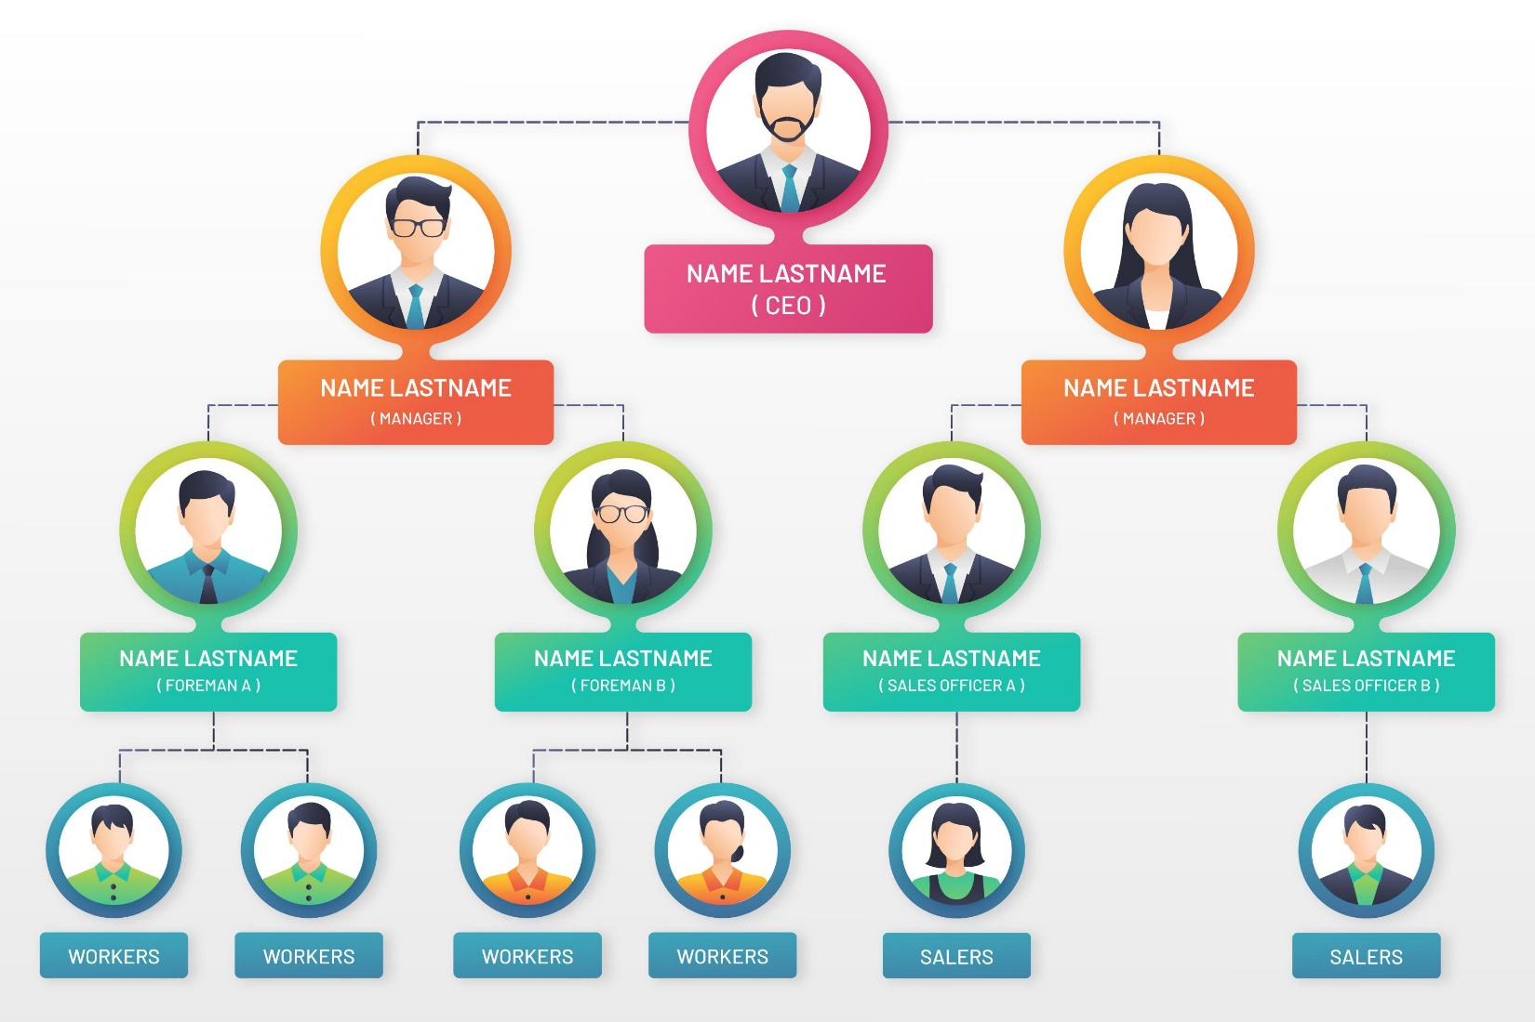

WHO ARE THE END USERS?

Slide 7

OUR SOLUTION AND ITS VALUE PROPOSITION
Conditional formatting is a feature found in spreadsheet software (such as Microsoft Excel, Google Sheets, etc.) that allows you to automatically apply formatting
A "filter" in the context of data management, particularly in spreadsheet software like Excel or Google Sheets, is a tool that allows you to view only the data that meets specific criteria, temporarily hiding the rest. When you "remove" a filter, you're undoing this action
A Pivot Summary refers to the aggregated and summarized data that results from using a pivot table in spreadsheet software like Microsoft Excel or Google Sheets
Graph data visualization is the process of representing data in a graphical format, such as charts, graphs, or maps, to make the data easier to understand and interpret

Slide 8
Dataset Description
FEATURES :
Employee ID: Unique identifier for each employee in the organization.(numerical )
First Name: The first name of the employee.(text)
Last Name: The last name of the employee.(text)
Employee Type: The type of employment the employee has (e.g., Full-time, Part-time, Contract) (text)
Performance Level : A level indicating the employee's performance level (e.g., very high, high, med,low) (text)
Gender: A code representing the gender of the employee (e.g., M for Male, F for Female, N for Non-binary).(text)
Current Employee Rating: The current rating or evaluation of the employee's overall performance.(numerical)

Slide 9

THE "WOW" IN OUR SOLUTION
PERFORMANCE LEVEL =IFS(Z8>=5,”VERY HIGH”, Z8>=4,”HIGH”, Z8>=3,”MED”, TRUE, “LOW”)
3/21/2024 Annual Review
9

Slide 10
MODELLING
Data collection is the process of gathering information from various sources to answer research questions, solve problems, or analyze trends.
Data cleaning is the process of preparing raw data for analysis by correcting or removing errors, inconsistencies, and inaccuracies.
Techniques ensures that the data is accurate, consistent, and ready for analysis, which is crucial for making reliable and informed decisions.
The result of data cleaning is a dataset that is accurate, consistent, and ready for analysis.
Charts and graphs are visual tools used to represent data, making it easier to understand patterns, trends, and relationships.
10

Slide 11
RESULTS
11

Slide 12
conclusion
The analysis reveals that employees involved in high-priority projects have consistently met or exceeded deadlines, contributing significantly to project success. Conversely, projects with high levels of team turnover or insufficient resource allocation experienced delays and quality issues.
Employees with specialized skills in project management and technical areas have demonstrated higher productivity and project success rates. There are noticeable variations in performance based on project complexity and team dynamics.

